Slide 1
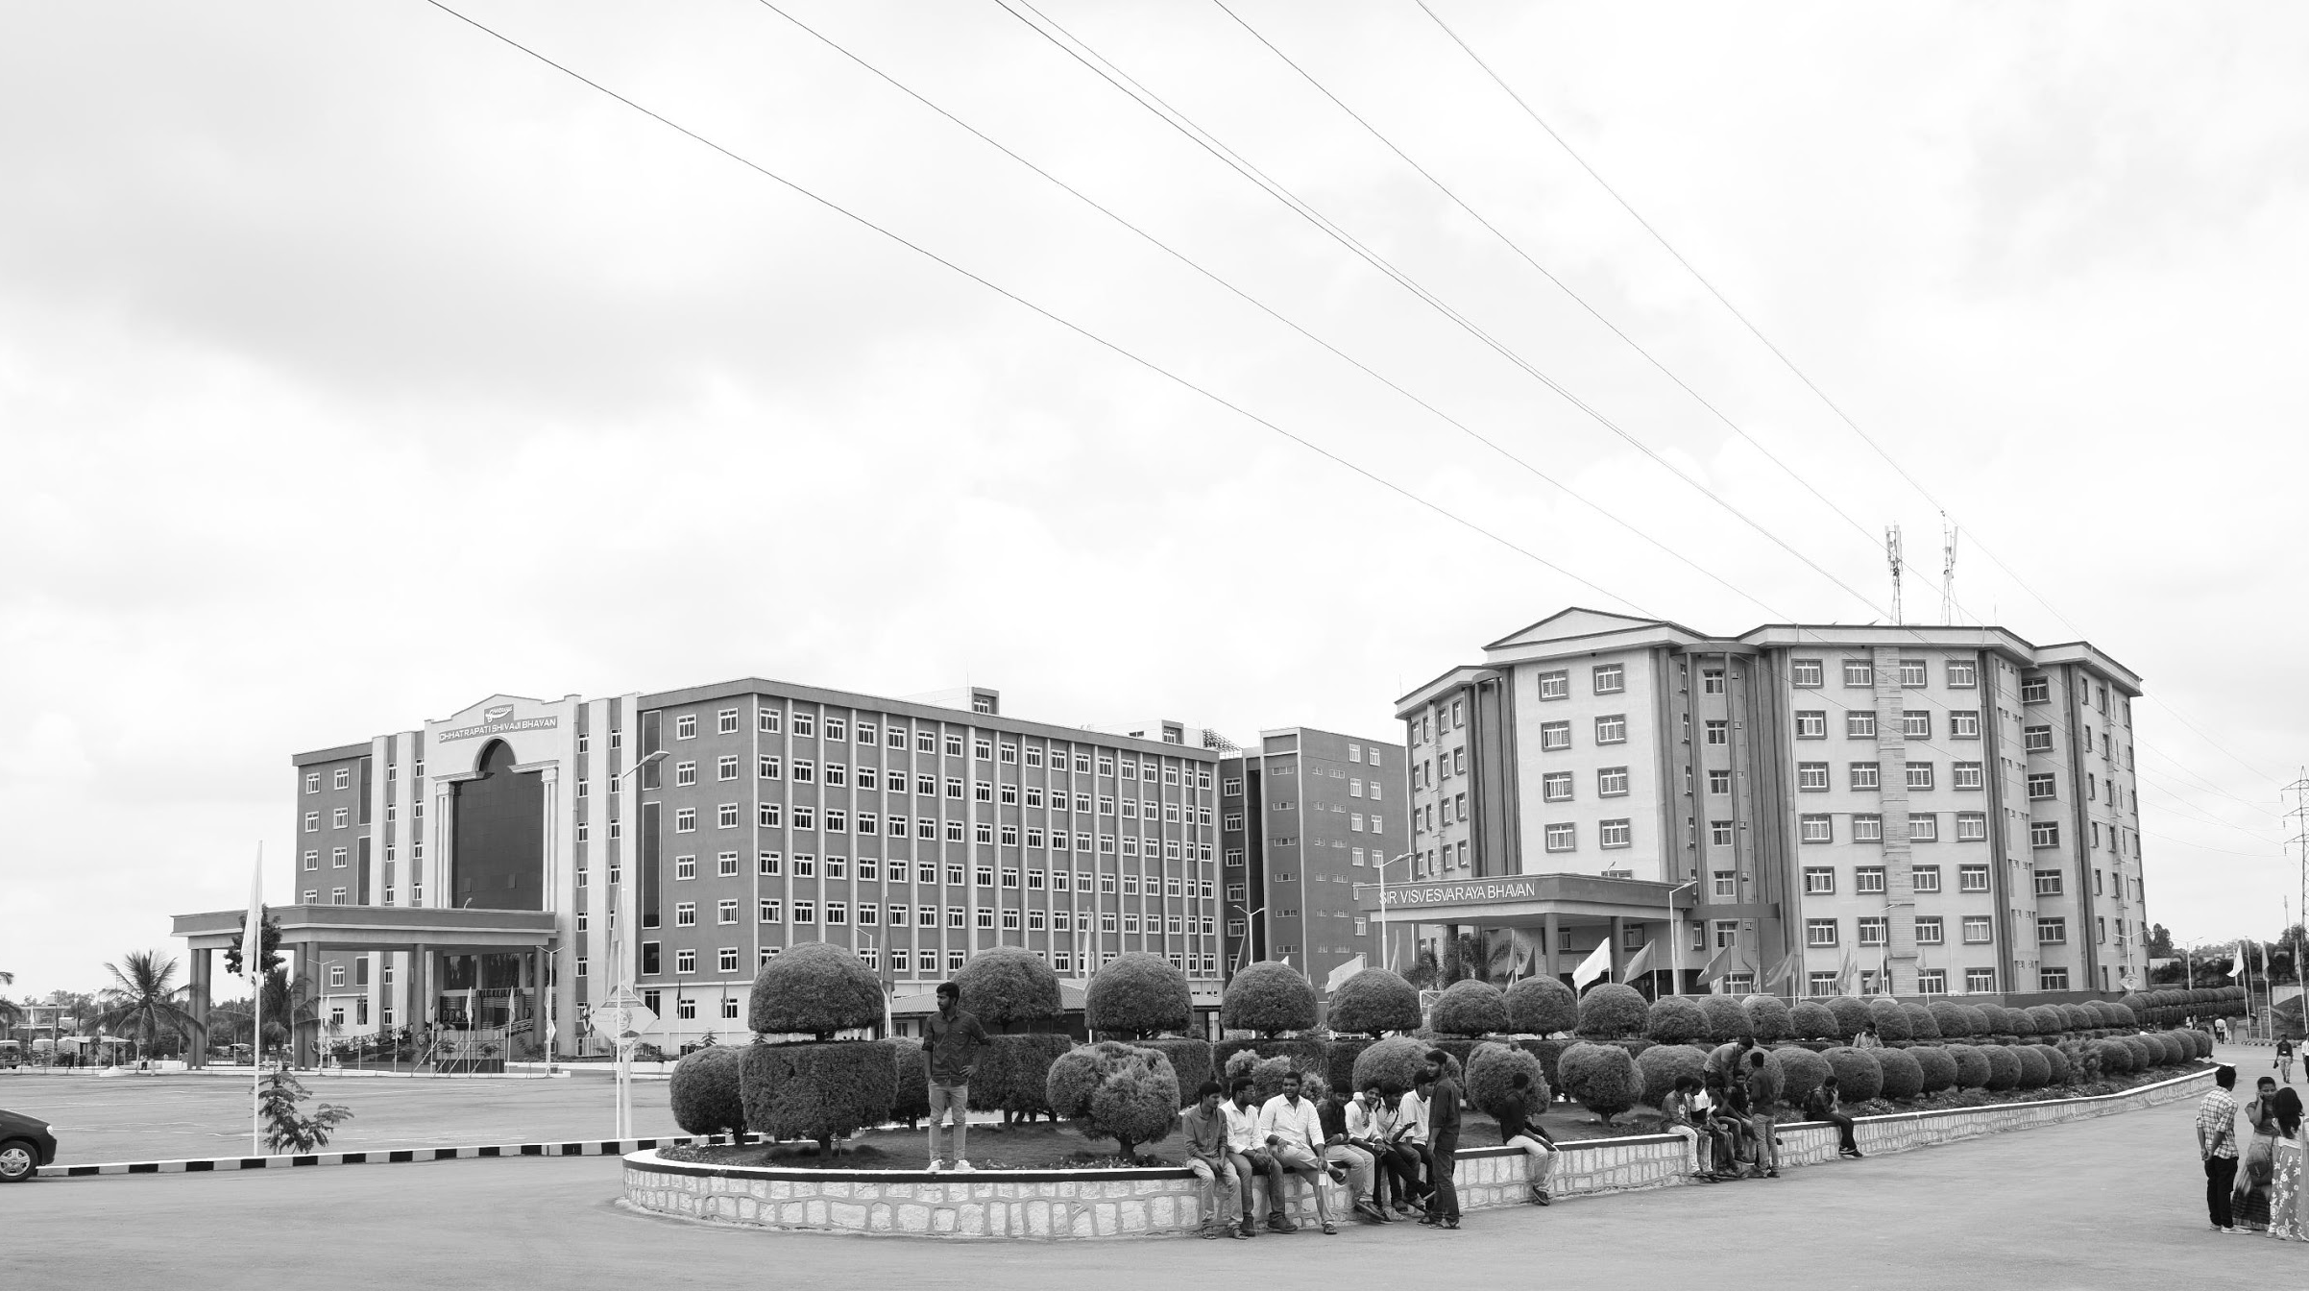

Robot for Drainage Blockage Systems
“Communications”
GITAM UNIVERSITY
CAPSTONE PROJECT
Project ID: CS13
Department of Electrical Electronics and Communication Engineering
Project Team:
NITHISH KUMAR MP - BU21EECE0100518
B.V. KISHORE KUMAR - BU21EECEO100333
M.SRI SAI HARSHITH - BU21EECEO100407
Project Guide:
Dr Ramesha M

Slide 2




Project Group – Details
Photo
Track
Roll No
Name
Photo
EECE
BU21EECE0100518
NITHISH KUMAR MP
Photo
EECE
BU21EECE0100333
B.V. KISHORE KUMAR
Photo
EECE
BU21EECE0100407
M.SRI SAI HARSHITH

Slide 3
Introduction
Drainage blockages can lead to flooding, contamination, and costly repairs.
This project presents an autonomous robotic system designed to efficiently detect and locate blockages in drainage networks.
The robot uses infrared and camera sensors to identify obstructions and assess pipe conditions, processing the data with image processing and neural network algorithms for precise blockage detection.
For navigation, the robot employs GPS and inertial measurement units (IMUs) to autonomously move through complex drainage systems.
Field tests have shown that the system is highly accurate and reliable, significantly reducing the time and cost of manual inspections and repairs while minimizing risks to human workers.
In summary, this autonomous robotic system enhances drainage maintenance by improving inspection efficiency and safety. Its use of components like Raspberry Pi, DC motors, stepper motors, Bluetooth modules, and the L293D motor shield makes it adaptable to various drainage systems, offering a safer, more efficient, and cost-effective solution for urban infrastructure maintenance.

Slide 4
Objective and Goals
Objective
The objective of this project is to develop an autonomous robotic system capable of detecting and locating blockages in urban drainage networks. The system aims to improve the efficiency, accuracy, and safety of drainage inspections by minimizing the need for manual labor and reducing the time and costs associated with maintenance operations.
Goals
Detect Blockages Accurately
Use sensors (ultrasonic, infrared, and cameras) to find blockages.
Autonomous Navigation
Enable the robot to move by itself using GPS and IMUs.
Affordable Design
Use components like Arduino Uno Board(level 1),Raspberry Pi (level 2) and motors to keep it low-cost.
Improve Safety & Save Time
Reduce the need for humans in risky inspections.

Slide 5
Project Plan

Slide 6
Milestones and Activities:
Research & Planning (5 July – 20 July):
Literature survey to study related work and available technologies.
Component selection for sensors, motors, and controllers.
Design & Development (21 July – 15 Aug):
Hardware design, software coding, and integrating navigation algorithms.
Prototyping & Assembly (16 Aug – 31 Aug):
Assembling the robotic components and system testing.
Testing & Validation (1 Sep – 15 Sep):
First iteration testing identifies issues.
Improvements and second iteration testing ensure performance accuracy.
Documentation & Presentation (16 Sep – 5 Oct):
Prepare the project report and final presentation slides.
Completion & Adjustments (6 Oct – 15 Oct):
Final tweaks or fixes before submission or demonstration.

Slide 7
Literature Survey
Ref No.​ | Title of paper​ | Abstract​ | Outcome​ | Methodology​ | Research gap​
1. | Self-Reconfigurable Drains Map Robot Which is Capable to Level Shift Specialized on Drain Maze. | The development of a quadruped drain mapping robot called Tarantula-II based on giraffe’s leg folding mechanism helps in traversing the uniqueness of drain system levels. | The drain mapping robot exhibits successful reconfiguration and level shifting ability that facilitates seamless mapping drains. | A biologically inspired leg mechanism, kinematic adjustments, and posture correction methods are employed in the robot design for level adaptation and stable motion. | Most of the robotic systems previously developed for drain inspection are not capable of attending to large drainage width and level adaptability hence the need for the design of more adaptable designs.
2​. | Raptor: A New Approach to the Drain Inspection Robot Design with Reconfigurable Features | This article outlines the Raptor who is a new drain inspection robot which has a manually adjustable wheel axle element to more effectively adapt to areas of various geometrics. | Results show that defenses Raptor's position thus allowing Raptor to center itself in the middle of drains which improves the efficaciousness and precision of the inspections. | The changeable design of the wheels of a robot was used and autonomous motion of the robot was performed on a fuzzy logic controller. | Already undertaken attempts to design drain inspection robots are characterized by some inflexibility in operational geometry and provision for autonomous relocation which Raptor rectifies.

Slide 8
Literature Survey
Ref No.​ | Title of paper​ | Abstract​ | Outcome​ | Methodology​ | Research gap​
3. | Modeling and Design of an Autonomous Drain Cleaning Robot | This paper proposes the development of an autonomous robot capable of clearing a sewer drain system without any safety concerns of the presence of an operator. | The sewer drain cleaning and inspection robot was able to manoeuvre within sewer pipes and dismantle clogs thus reducing the amount of manual scavenging and error prone and expensive equipment. | In order to clear blockages the robot works with ultrasonic sensors and infrared cameras located on a robot’s metal parts controlled by Raspberry Pi. | Current alternatives lack an affordable and safe yet effective means of unblocking sewer pipelines across different diameters.
4. | Development of a Pipeline Cleaning Robot for Enhanced Maintenance and Inspection | This paper presents a robotic system for the internal inspection and cleaning of pipelines and offers the possibility of direct video feedback from the robot to assist in pipe repair work. | The robot is capable of cleaning the internal section of these pipelines and sends the video images captured during operation which enhances the monitoring process. | In cleaning, this robot has a hand with a brush and operates through remote control with the combination of several systems such as mobility system and wireless communication. | The current methodologies applied in cleaning of pipelines are expensive and offer no real-time feedback thus, there is a need for more effective and more informative methods.

Slide 9
Literature Survey
Ref No.​ | Title of paper​ | Abstract​ | Outcome​ | Methodology​ | Research gap​
5. | Robotic System for Cleaning of Pipeline, Drainage and Manholes. | The focus of the paper is on the development of a robotic system which can automatically clean pipes, sewers and manholes, thus enhancing waste management by all safety, speed, and efficiency measures. | The robotic system helps restore sewers and pipelines by removing obstructions, reducing the risk of human workforce in dangerous activities. | A robotic arm fitted with cameras and sensors, which is connected to the control unit, was used to detect, locate and clear blockages in-situ. | Even though manual methods of cleaning still exist, they pose threats to health and time with their inefficiency thus the necessity for robotic cleaning methods.
6. | Creation of Semi-Automatic Sewage Cleaning Machine for Improved Safety and Efficiency | In this work, a machine for cleaning sewage has been designed to minimize the risk to scavenger health and the need for manual operation of the device. | The machine reduces human exposure to contaminated sewage by bypassing the need for human direct involvement in operations with hazardous wastes. | A pneumatic piston cylinder and linkage mechanisms and Arduino controlled via Bluetooth are employed to perform automation of the process of sewage cleaning. | Insite of all the efforts scaled up towards automation of processes and equipment, the quest for cheaper and even better and efficient sewage cleaning options continues.

Slide 10
Analysis - SWOT
Strengths
Weaknesses
S1. Autonomous Navigation
S2. Cost-Effective
S3. Adaptability
W1. Initial Setup Cost
W2. Limited Battery Life
W3. Dependency on Sensors
W4. Maintenance Needs
Opportunities
Threats
T1. Technological Competition
T2. Regulatory Hurdles
O1. Urban Expansion
02. Government Initiatives
O3. Environmental Impact
04. Commercial Applications

Slide 11
Analysis – 4W1H
Why:
To reduce manual inspection risks and improve drainage maintenance.
What:
Build an autonomous robot to detect and locate drainage blockages.
Where:
Applicable to urban drainage systems in India.
When:
Planned completion during the current academic year.
Field tests throughout the project lifecycle to validate results.
How:
Use sensors, GPS, image processing, and neural networks for navigation and blockage detection.
Refined Objective:
Enhance safety and efficiency in detecting drainage blockages.
Reduce manual intervention, prevent urban flooding, and maintain infrastructure.

Slide 12
Goal of Project:
Implement effective strategies and technologies to minimize the frequency and severity of drainage blockages in urban areas.
Prevent blockages that lead to flooding and water contamination, thereby reducing the spread of waterborne diseases and improving overall public safety.
Strengthen and maintain drainage systems to withstand the challenges posed by rapid urbanization, aging infrastructure, and extreme weather events.
Utilize advanced technologies, such as smart monitoring systems, to streamline and improve the efficiency of drainage maintenance and management.

Slide 13
Methodology:
Manual Cleaning: Pay attention to drainage systems and regularly work through obstructions with manual means such as rods and shovels. Take away the particles and dirt that can cause them to become jammed.
Mechanical Cleaning: Clean blockages with high pressure water jets and make use of suction trucks that can remove dirt and sludge from within a pipe
Advanced Technology : Check the insides of pipes for blockages without the need for excavation.
Robots: Clean and inspect confined spaces using a robotic system. Sensors: Use audial as well as ultrasonic sensors for delicate obstruction detection.
Smart Drainage: Designed systems that understand such imperfections in the irrigation system by using real time structural integrity systems and twilight technology. Regulations: Enforce building codes and curb the drainage system through support to drainage infrastructural services by private firms.

Slide 14
Power Supply
(Battery Pack)
Flow Chart
Control Unit
(Arduino Uno Board)
Navigation System
(Motor Driver, DC/Stepper Motors)
Sensors
(Ultrasonic)

Slide 15
Data Processing
(Arduino Uno Board)
Communication System
(Arduino, Wi-Fi)
Actuators
(Servo Motors)
User Interface
(Manual Monitoring)

Slide 16
Architecture
Structural Diagram
Block Diagram/Pin Diagram
User Interface
(Remote Monitoring)
Control Unit (Raspberry Pi)
Communication Module
Actuators (Motors)
Sensors
Power Supply

Slide 17
Use Cases & Testing
Use Cases
City Drain Blockage Detection:
Automatically find and clear blockages in city drainage systems to prevent flooding.
Critical Benefit: Reduces manual labor and improves public safety.
Routine Drain Maintenance:
Regularly inspect drainage systems to prevent blockages before they occur.
Critical Benefit: Saves time, lowers maintenance costs, and prevents major issues.
Post-Flood Blockage Inspection:
Quickly detect and remove debris after floods to restore proper drainage.
Critical Benefit: Speeds up recovery efforts and minimizes further damage.

Slide 18
Test cases
Accuracy of Blockage Detection:
Test the robot’s ability to precisely detect different types of blockages (e.g., solid waste, grease).
Critical Insight: Ensures reliable performance in real-world conditions.
Robot Navigation and Obstacle Handling:
Ensure the robot can navigate complex drainage networks without getting stuck.
Critical Insight: Validates the robot’s autonomous movement capabilities.
Long-term Reliability:
Test the robot’s durability in tough conditions, such as waterlogged drains.
Critical Insight: Confirms it can handle repeated use and tough environments.

Slide 19
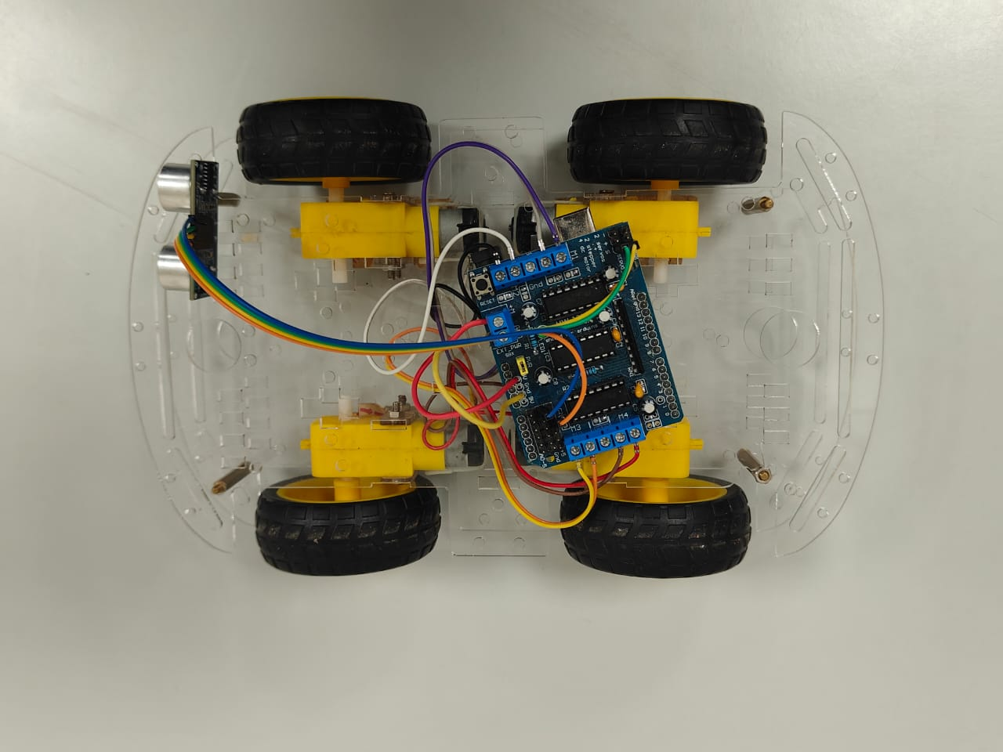
Results
The report on drainage blockage in India highlights challenges due to outdated infrastructure, rapid urbanization, and solid waste accumulation, including plastics and food debris. Domestic disposal of fats, oils, and grease (FOG), along with tree root intrusion, construction debris, and sedimentation, worsen the problem. These blockages lead to urban flooding, health risks, environmental pollution, and economic losses.

Slide 20
Contribution
Team Progress and Movement
Dataset Collection
Data Labelling and Annotation
Model Training
Testing
Deployment and Monitoring
Individual Contribution
Key contributions: Nitish Kumar MP
Sensor Integration
System Assembly
Key contributions: B.V. Kishore Kumar
Navigation System
Field Testing
Key contributions: M. Sri Sai Harshith
AI Model Training
Model Testing

Slide 21
Conclusion & Future Work
Summary and Conclusion
The autonomous robotic system enhances drainage maintenance by improving inspection efficiency and safety.
Its scalable and adaptable design, using Raspberry Pi, DC motors, stepper motors, Bluetooth modules, and the L293D motor shield.
It offers a safer, more efficient, and cost-effective solution for urban infrastructure maintenance.
Future Work
The future outlook for managing drainage blockages in India focuses on using smart technologies like IoT sensors for real-time monitoring and early detection of issues. There’s also a push for Sustainable Drainage Systems (SuDS), which help reduce water runoff. Public-private partnerships are seen as key to improving infrastructure and maintenance. Overall, a mix of advanced technologies, better planning, and proactive strategies is needed to create more efficient and resilient drainage systems

Slide 22
References
Parween, R.; Hayat, A.A.; Elangovan, K.; Apuroop, K.G.S.; Heredia, M.V.; Elara, M.R. Design of a Self-Reconfigurable Drain Mapping Robot With Level-Shifting Capability. IEEE Access 2020, 8, 113429–11344
Muthugala, M.A.V.J.; Palanisamy, P.; Samarakoon, S.M.B.P.; Padmanabha, S.G.A.; Elara, M.R.; Terntzer, D.N. Raptor: A Design of a Drain Inspection Robot. In Sensors; MDPI: Basel, Switzerland, 2021; pp. 5742–5761.
Sulthana, S.F.; Kumar, S.; Mathur, S.; Mohile, T.A. Modelling and design of a drain cleaning robot. In 3rd International Conference on Advances in Mechanical Engineering (ICAME 2020); IOP Publishing: Bristol, UK, 2020; pp. 022049.
M, Sowmya; Vismitha, V.; Shreya, G.; Hussian, S.; Reddy, V. Pipeline cleaning robot. International Journal of Research in Engineering and Science 2023, 11, 624–628.
Sanjana, K. Pipeline, sewage, and manhole cleaning robotic. In International Research Journal of Modernization in Engineering, Technology and Science; IRJMETS: Bangalore, India, 2022; pp. 5201–5206.
Ramanathan, S.; Sudharshan, R.; Karthik, B.; Suhail, A.M.; Chiranjeev, S. Sewage cleaning machine. In International Journal of Research and Analytical Reviews; IJRAR: Chennai, India, 2019; pp. 124–129.

Slide 23

THANK YOU

